Slide 1


ICC T20 WorldCup 2024 Analysis
Ultimate Winning XI
A Data Visualization Project Using Power BI, Excel and Python

Slide 2
ICC T20 WorldCup 2024 Analysis
Project Overview
1
web scraping Data from the ESPN website,
2
A Power BI Dashboard was created to analyze and compare the performances of all players participating in the ICC T20 Men's Cricket World Cup 2024. The dashboard serves as an interactive platform, enabling users to evaluate player performances based on specific criteria. The primary objective is to facilitate the selection of the best 11 players of the tournament, using a data-driven approach to identify the top performers.
Next, we will identify attributes they are doing right and create a perceptual map. In the perceptual map, we will identify a criteria and rank these attributes as high or low.
Data Cleaning, processing and visualization
3
Final Interactive Dashboard to make final 11 team on detailed performance metrics

Slide 3

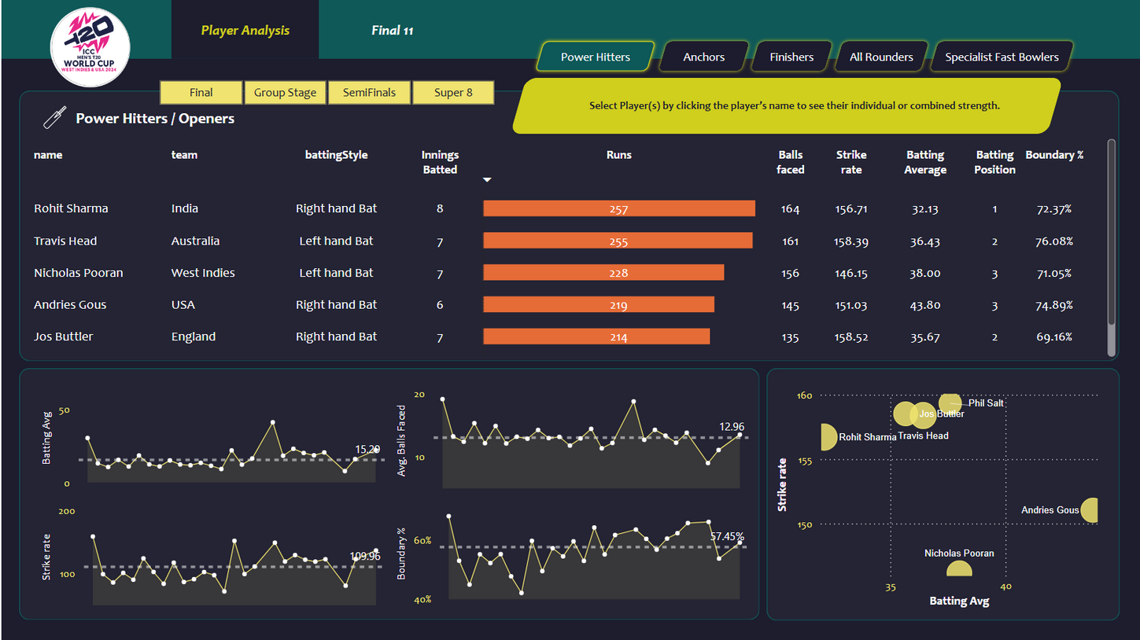
Power Hitters/Openers
Openers play a crucial role in setting the foundation for a team's innings. They face the new ball, often against the opposition's best bowlers, and are responsible for providing a strong start.
These players are top-order batsmen with a batting average over 30, a strike rate above 140, and boundary percentage exceeding 50%, typically batting in positions 1-4.

Slide 4
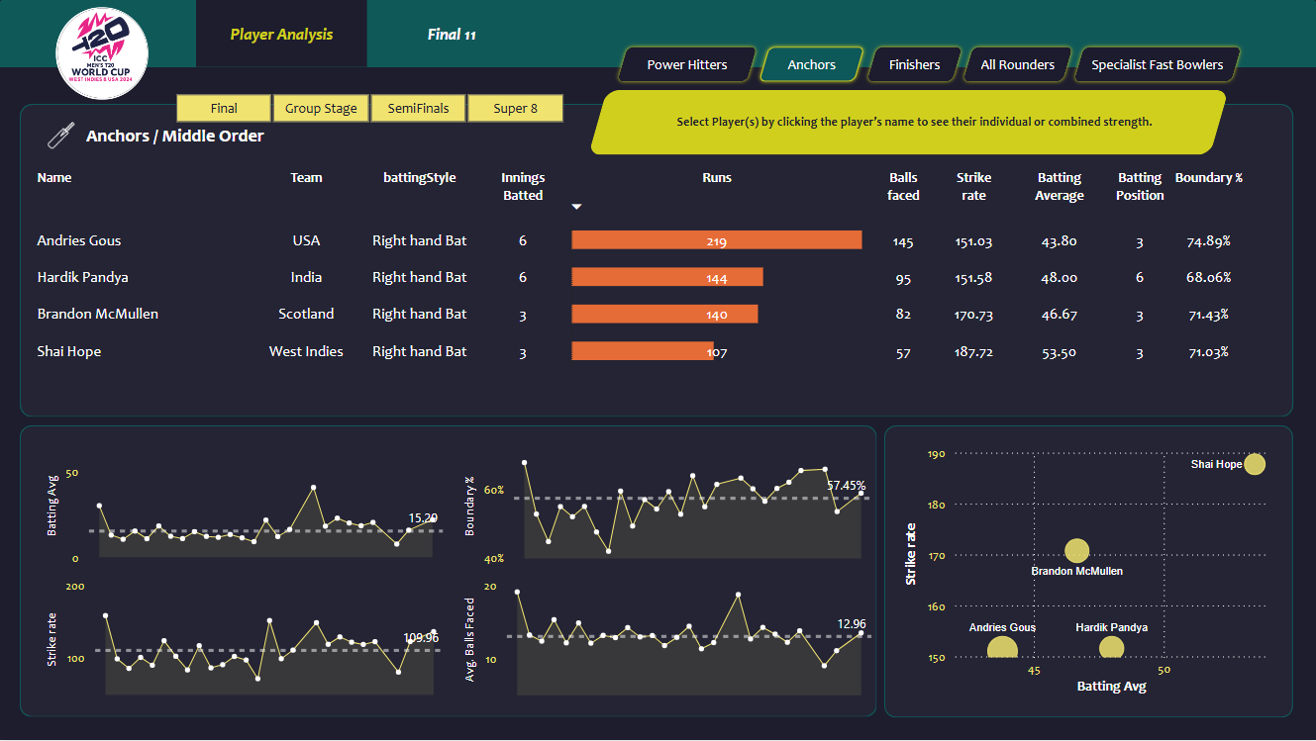
Anchors/Middle Order
Anchors or middle-order batsmen are pivotal in stabilizing the innings, especially after early wickets.
They ensure the team builds a solid total by rotating the strike and setting up a platform for finishing strong.
These players typically bat in positions 3-7, with a batting average over 40, a strike rate above 120, and an average of more than 15 balls faced per innings.

Slide 5
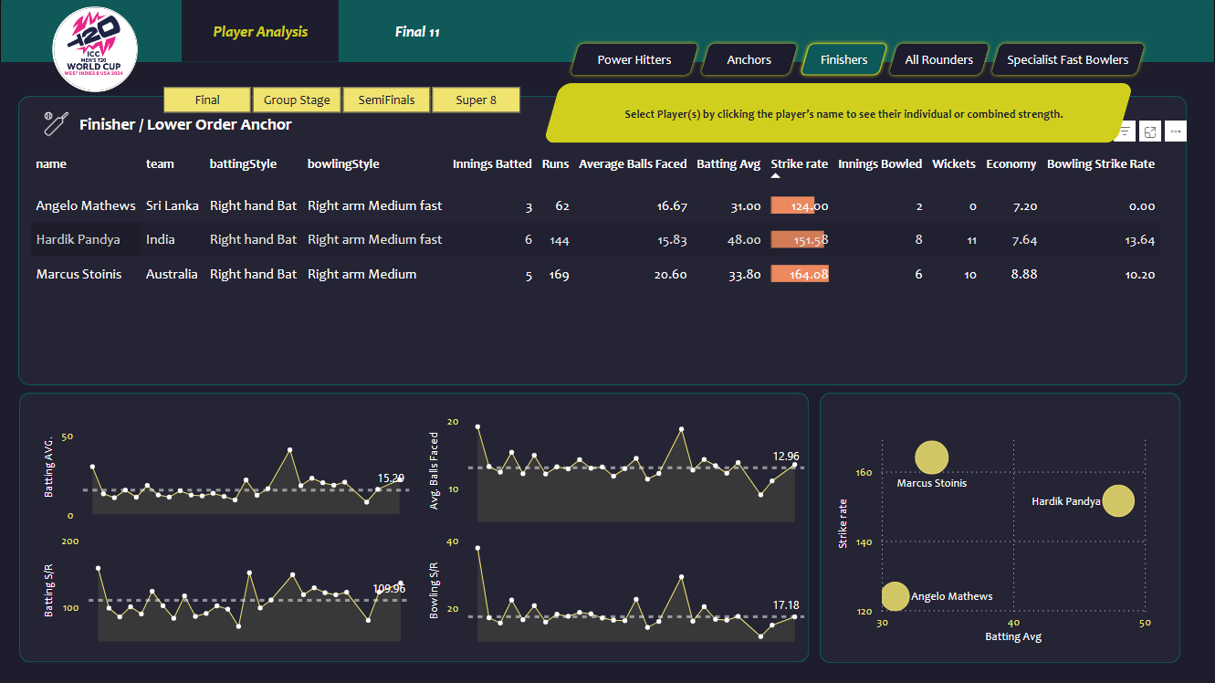
Finishers/Lower Order Anchor
Finishers or lower middle-order batsmen play a crucial role in the latter stages of an innings, often tasked with closing out games under pressure. Their primary responsibility is to accelerate the scoring rate, capitalize on the platform set by the top order, and guide the team to a competitive total or chase down targets in tight situations.
These players typically bat in positions 5-7, with a batting average over 25, a strike rate above 100, and an average of more than 12 balls faced per innings.

Slide 6
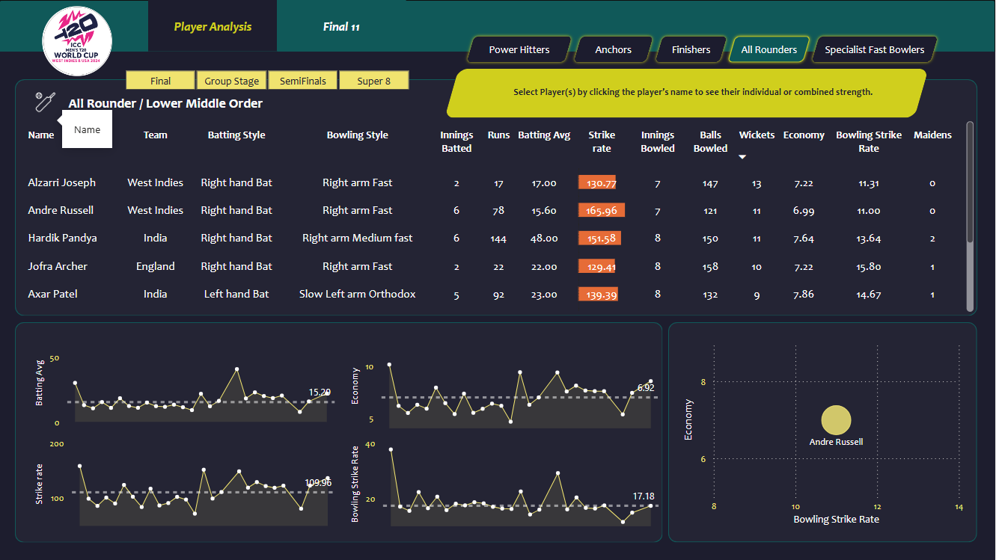
All-Rounders
All-Rounders are versatile players who contribute significantly with both bat and ball.
Their dual skills provide balance to the team, offering depth and flexibility in both batting and bowling, and they play a key role in changing the game's momentum.
hey typically bat in positions 3-7 and have a batting average over 12 with a strike rate above 100. In addition to their batting prowess, they are effective bowlers, maintaining an economy rate of less than 8 and a bowling strike rate under 20.

Slide 7
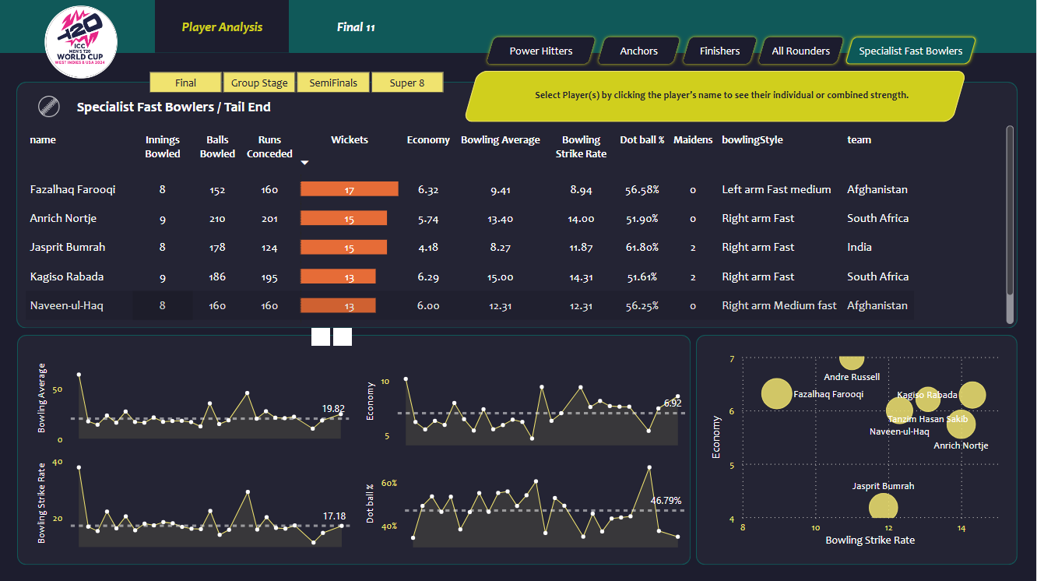
Specialist Fast Bowlers
Specialist fast bowlers are crucial for delivering pace and extracting bounce from the pitch.
Their fast bowling style and ability to deliver consistent pace make them key players in breaking partnerships and controlling the game's tempo.
They maintain an economy rate of less than 7 and a bowling strike rate under 16. With a bowling average below 20 and a dot ball percentage exceeding 50%, they effectively restrict scoring and apply pressure on batsmen.

Slide 8
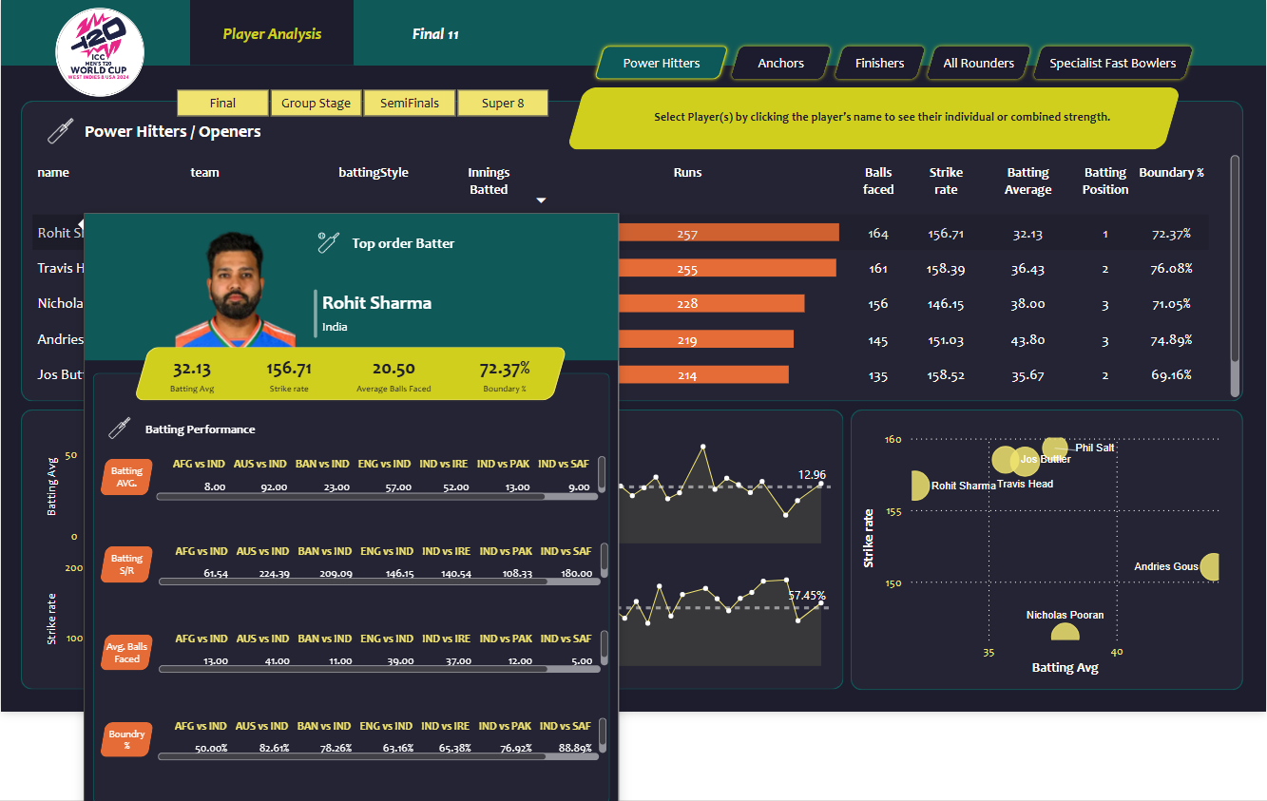
PlayerInformation
Comprehensive snapshot of player information, showcasing key metrics such as batting average, strike rate, boundary% or economy rate, etc.
It also includes detailed performance data from past matches, highlighting each player's recent batting or bowling achievements.
This visual summary allows for a quick assessment of player form, consistency, and impact, aiding in strategic decision-making and performance evaluation.
On Hovering PlayerName

Slide 9
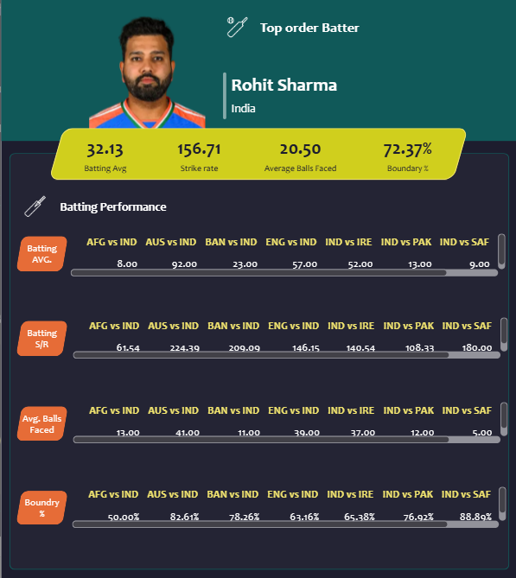
PlayerInformation

Slide 10
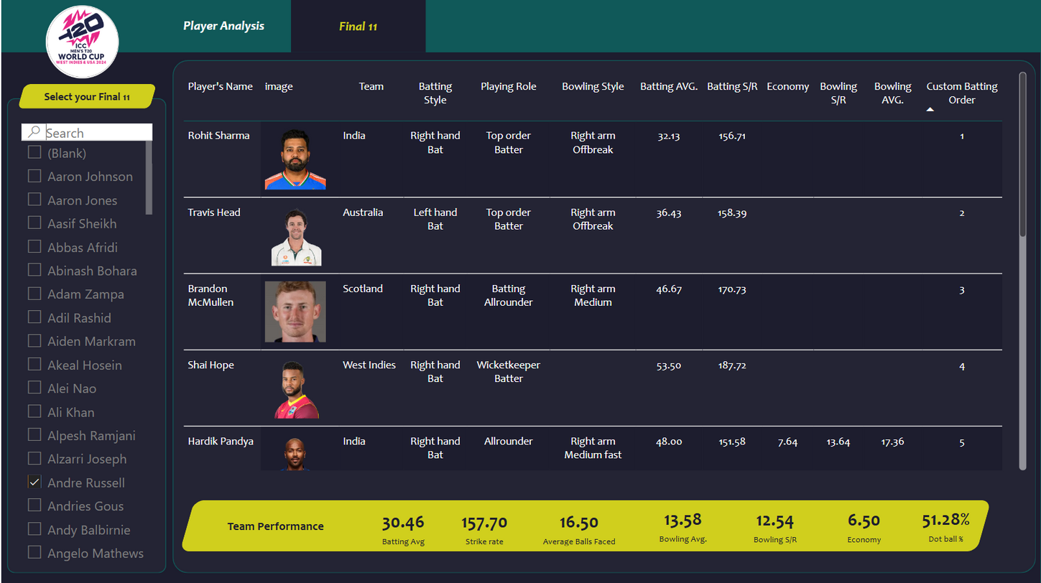
Ultimate Winning XI
Based on comprehensive data analysis, the selected 11 players form an "Ultimate Winning Team" with outstanding performance metrics.
The team boasts an impressive batting average of 30.456 and a high strike rate of 157.7. Their bowling performance includes a remarkable bowling average of 13.58, bowling strike rate of 12.54, and an economy rate of 6.5. Additionally, the team maintains a dot ball % of 51.28%, showcasing their ability to restrict the opposition effectively while delivering strong batting and bowling contributions.

Slide 11


ICC T20 WorldCup 2024 Analysis
1
Scan to view the live dashboard!
Note
You can explore the live interactive dashboard by scanning the QR code.
This will give you instant access to detailed player performance analysis and insights.

Slide 12
ICC T20 WorldCup 2024 Analysis
Thank you!
Have
a great day!

